Slide 1

Unit I: Descriptive Statistics & Data Understanding
CSE552 — Business Analytics
Session 2026-27

Slide 2
Learning Objectives (CO1, CO2)
By the end of this unit, you will be able to:
Classify data into quantitative & qualitative types Compute and interpret measures of central tendency Compute and interpret measures of dispersion Perform and interpret correlation analysis
Describe business problems using analytical models

Slide 3
1. Introduction to Statistics
What is Statistics?
Statistics is the science of collecting, organizing, presenting, analyzing, and interpreting data to make informed decisions.
Branches of Statistics
Branch | Definition | Example
Descriptive | Summarizes & describes data features | Mean sales, standard deviation of profits
Inferential | Draws conclusions about a population from a sample | Estimating average customer satisfaction from a survey

Slide 4
Descriptive vs Inferential
Feature | Descriptive Statistics | Inferential Statistics
Primary Goal | To organize, summarize, and describe the characteristics of a known dataset. | To draw conclusions, test hypotheses, and make predictions about a larger population based on a sample.
Data Usage | Utilizes data from the entire population or a complete, defined sample set. | Utilizes data strictly from a smaller representative sample to estimate larger population parameters.
Level of Certainty | Exact; represents hard facts of the known data with zero uncertainty or sampling error. | Involves probability, carrying a margin of error and a quantified level of uncertainty.
Common Metrics | Measures of central tendency (Mean, Median, Mode) and Measures of spread (Range, Variance, Standard Deviation). | Hypothesis tests (t-test, ANOVA, Chi-square), confidence intervals, and regression analysis.
Typical Outputs | Frequency distribution tables, pie charts, bar graphs, and summary statistics. | Probability values (p-values), confidence levels, and margin of error estimates.
Generalizability | Low; findings are strictly limited to the specific group or data analyzed. | High; findings are inferred to apply to a wider, often unmeasured population.

Slide 5
1.1 Types of Statistics — Deep Dive
Descriptive Statistics
Purpose: Simplify large datasets into meaningful summaries Tools: Tables, graphs, measures of central tendency & dispersion Scope: Describes only the dataset at hand
Inferential Statistics
Purpose: Generalize from sample to population
Tools: Hypothesis testing, confidence intervals, regression
Scope: Makes predictions & decisions under uncertainty
Analogy: Descriptive = "What happened?" | Inferential = "What will happen?"

Slide 6
Real-world examples from different domains.
Scenario | Descriptive Statistics | Inferential Statistics
College | Average marks of 200 students are 72%, highest is 96%, lowest is 34%. | Based on these 200 students, estimate the average marks of all 5,000 students in the university.
E-commerce | Last month's sales: ₹15 lakh revenue, average order value = ₹1,250, top-selling category = Electronics. | Predict next month's sales based on customer purchasing trends.
Weather | Average temperature in Delhi last June = 39°C. | Predict this year's June temperature using historical data.
Manufacturing | Out of 10,000 bulbs produced, 95 were defective (0.95%). | Estimate the defect rate of all future production batches.
Banking | Average customer account balance = ₹82,000. | Estimate the average balance of all customers from a sample of accounts.
Sports | Virat scored 650 runs this season with an average of 54.2. | Predict his average runs next season based on past performance.

Slide 7
2. Types of Data
Classification Framework
Data
├── Quantitative (Numeric)
│ ├── Discrete → Countable (e.g., number of orders)
│
│
└── Continuous → Measurable (e.g., weight, temperature)
└── Qualitative (Categorical)
├── Nominal
└── Ordinal
→ No order (e.g., gender, color)
→ Ordered (e.g., ratings: Poor < Fair < Good)

Slide 8
Examples
Variable | Data Type | Reason
Number of students in a classroom | Discrete | Countable whole numbers
Student's height | Continuous | Measured with decimal values
Branch (CSE, IT, Civil, Mechanical) | Nominal | Categories without order
Semester (1st, 2nd, 3rd, 4th...) | Ordinal | Ordered categories
Number of assignments submitted | Discrete | Countable
CGPA (8.45, 7.82, etc.) | Continuous | Can take decimal values
Hostel Type (Boys, Girls, Day Scholar) | Nominal | No ranking
Performance Grade (Poor, Average, Good, Excellent) | Ordinal | Ordered levels

Slide 9
2.1 Data Types — Business Examples
Data Type | Business Example | Analysis Suitable
Discrete | Number of transactions per day | Count models, bar charts
Continuous | Revenue, profit margin | Histograms, mean, SD
Nominal | Product category, region | Frequency tables, mode
Ordinal | Customer satisfaction (1-5) | Median, percentiles
Measurement Scales
Nominal — Identity only
Ordinal — Identity + Order
Interval — Identity + Order + Equal intervals (no true zero; Zero does not mean "nothing." ie 0°C)
Ratio — All above + True zero (most powerful)

Slide 10


The four measurement scales tell us what kind of analysis can be performed on data.
Scale | Characteristics | Examples | Can You...?
Nominal | Identity only (labels/categories) | Gender, Blood Group, Department (CSE, IT, ECE), Eye Color | ✔ Count ✔ Find Mode Compare order Calculate Mean
Ordinal | Identity + Order | Class Rank (1st, 2nd, 3rd), Satisfaction (Poor, Fair, Good, Excellent), Education Level (Bachelor's, Master's, PhD) | ✔ Rank ✔ Find Median ✔ Compare order Differences between ranks are not equal
Interval | Identity + Order + Equal Intervals (No true zero) | Temperature in °C or °F, IQ Score, Calendar Year | ✔ Add/Subtract ✔ Mean ✔ Standard Deviation Ratios are meaningless
Ratio | Identity + Order + Equal Intervals + True Zero | Height, Weight, Age, Income, Distance, Time, Number of Students | ✔ All arithmetic (+, –, ×, ÷) ✔ Ratios ✔ Mean ✔ Standard Deviation

Slide 11

3. Measures of Central Tendency
Definition
A single value that represents the center or typical value of a dataset.
Three Key Measures
Measure | Formula | Best For | Sensitive to Outliers?
Mean (Arithmetic) |  | Symmetric, continuous data | Yes
Median | Middle value when sorted | Skewed data, ordinal data | No
Mode | Most frequent value | Categorical data, multimodal data | No

Slide 12
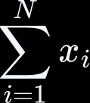

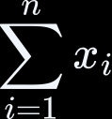

3.1 Mean — Mathematical Foundation
Population Mean
Sample Mean
Weighted Mean
Business Use: Weighted average of product ratings by purchase volume.

Slide 13
3.1 Mean — Mathematical Foundation contd.
Statistic | Description | Symbol & Formula | Primary Use
Population Mean | The average of all members in a given population. This is considered an exact "parameter". | (Sum of all values / total population size (N)) | Census data or exact group averages when the entire group is known.
Sample Mean | The average of a subset of the population. This is a "statistic" used to estimate the population mean. | (Sum of all sample values / sample size (n)) | Polling, quality control, or medical studies where measuring the whole population is impossible.
Weighted Mean | An average where each value is multiplied by a "weight" representing its relative importance or frequency. | (Sum of each value * its weight / sum of all weights) | Calculating GPAs, stock portfolios, or final grades where some assignments count more than others.

Slide 14




3.2 Median & Mode : Theory
Median
For odd :
For even :
Mode
Value with highest frequency
Dataset can be: unimodal, bimodal, or multimodal

Slide 15
When to Use What?
Symmetric Distribution Skewed Distribution Categorical Data
→ Mean
→ Median
→ Mode
Situation | Data | Best Measure | Example
Symmetric Distribution | 65, 70, 75, 80, 85 | Mean | Average marks of students in a class where scores are evenly distributed.
Skewed Distribution | 25,000, 30,000, 35,000, 40,000, 5,00,000 | Median | Monthly salaries in a company where the CEO earns much more than everyone else.
Categorical Data | Red, Blue, Blue, Green, Blue, Red | Mode | Most preferred mobile color is Blue (appears most frequently).

Slide 16
Mode
In statistics,
The mode is the most frequently occurring value in a dataset.
Visually represented as a "peak" on a graph.
Unimodal: Datasets with one single peak.
This often indicates a single, uniform population (e.g., adult male heights).
Bimodal: Datasets with two distinct peaks.
This usually suggests the data contains two combined subgroups with different traits or behaviors
(e.g., a dataset combining test scores for advanced students and beginners, or website traffic peaking twice a day for breakfast and dinner).
Multimodal: Datasets with three or more peaks.
This indicates multiple underlying clusters or trends
(e.g., city traffic peaking during morning rush hour, school drop-offs, and evening rush hour).

Slide 17





Grouped Data
When data is collected in large amounts, it is often arranged into class intervals. Such data is called grouped data.
The mean, median, and mode for grouped data are statistical values estimated using class midpoints, cumulative frequencies, and modal class boundaries instead of raw individual data points.
Mean = ∑(f_{i}.x_{i})/∑f_{i} Median =
Mode=

Slide 18


Mean Example: Direct Method for Calculating Mean
Class Interval | 0-10 | 10-20 | 20-30 | 30-40 | 40-50
Frequency | 12 | 16 | 6 | 7 | 9
Class Interval | Frequency | Class Mark | ( )
0-10 | 12 | 5 | 60
Oct-20 | 16 | 15 | 240
20-30 | 6 | 25 | 150
30-40 | 7 | 35 | 245
40-50 | 9 | 45 | 405
 | =50 |  | =1100
Mean =
= 1100/50 = 22

Slide 19




How to Find the Median Class
Calculate the total frequency (N). Divide (N) by two (N/2).
Check the cumulative frequency column. Find the first value exceeding (N/2).
Choose that corresponding class interval.
Now Calculating the Exact Median using formula:
(L) (lower limit of median class)
(cumulative frequency of preceding class)
(f) (frequency of median class) class width = (10)

Slide 20







Median Example:
Class Interval | Frequency (f) | Cumulative Frequency (CF)
(0 - 10) | 5 | 5
(10 - 20) | 8 | 13
(20 - 30) (Median Class) | 12 | 25
(30 - 40) | 7 | 32
(40 - 50) | 3 | 35
 | N= =35 | 110
Calculate the :
Look at (CF) Column:
and the median interval is:
Find the cumulative frequency just greater than (17.5) = 25; corresponding class interval is (20 - 30).
=

Slide 21




Calculating Mode
Mode=
L lower limit of modal class frequency of modal class frequency of preceding class frequency of succeeding class
h class width

Slide 22




Class Interval | Frequency ((f))
(0 - 10) | 5
(10 - 20) | 8
(20 - 30) (Modal Class) | (12) (Highest Frequency)
(30 - 40) | 7
(40 - 50) | 3
Identify Highest Frequency: The largest number in the frequency column is 12. Identify Modal Class: The interval corresponding to 12 is
Mode= = =
=20+4.44=
=

Slide 23
# Practice Problem for Mean, Median and Mode
Score Range | Frequency
40-50 | 3
50-60 | 5
60-70 | 8
70-80 | 6
80-90 | 2
90-100 | 1
Q: Find the mean, median and mode for the above data.
Class Interval | Frequency
10 – 20 | 5
20 – 30 | x
30 – 40 | 20
40 – 50 | 10
50 – 60 | 5
Q: The mode of the following frequency distribution is 30. Find the missing frequency x.

Slide 24
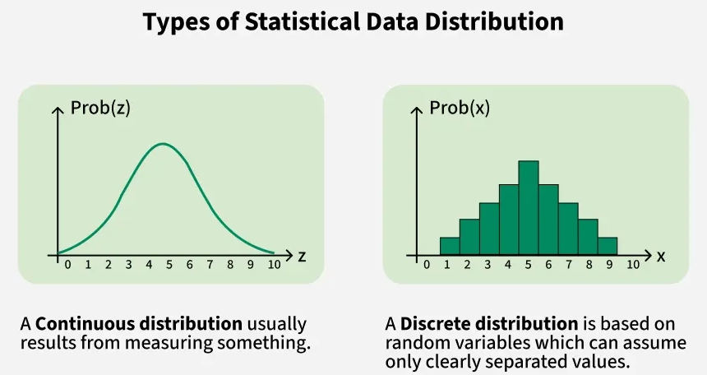
Distribution
A statistical distribution shows all possible values for a variable and how often they occur.
Core Measures
Center: Mean, median, and mode show where data clusters.
Spread: Variance and standard deviation show how far data points stray from the center.
Shape: Skewness and kurtosis show symmetry and peak sharpness

Slide 25
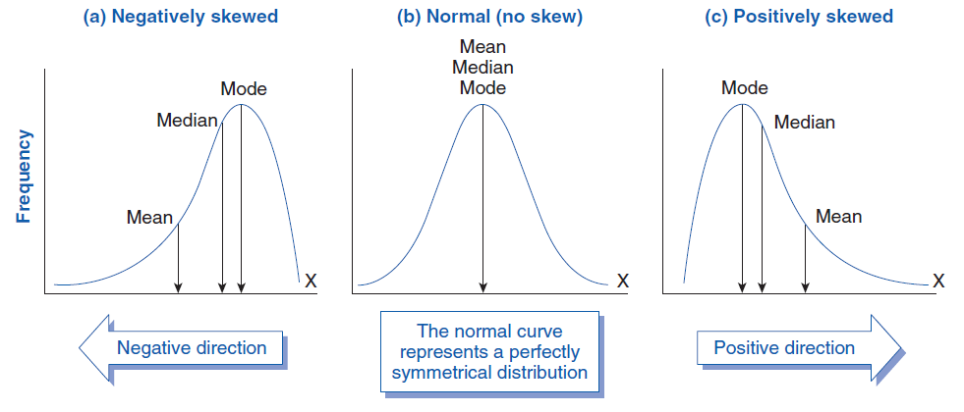
Distribution Types
Symmetric Distribution → Mean:
In a perfectly symmetrical bell curve, the mean sits exactly in the center.
It uses every data point, making it the most efficient measure when there are no outliers.
Skewed Distribution → Median:
Skewed data has long tails or extreme outliers that pull the mean away from the center.
The median is "robust" because it ignores the actual values of extremes and simply finds the middle point.
Categorical Data → Mode:
You cannot calculate a mathematical average (mean) or line up values in order (median) for non-numerical categories like "colors" or "car models."
The mode simply tells you the most frequent category.

Slide 26
3.3 Practical: Python Implementation
Computing Central Tendency
import numpy as np from scipy import stats
# Sample dataset: Monthly sales (in thousands) sales = [45, 52, 48, 60, 55, 58, 62, 50, 47, 200]
# 200 = outlier
# Mean
mean_sales = np.mean(sales) print(f"Mean: {mean_sales:.2f}")
# 67.70 (skewed by outlier)
# Median
median_sales = np.median(sales) print(f"Median: {median_sales:.2f}")
# 53.50 (robust)
# Mode : keepdims=True, the output array has the exact same number of dimensions as the input array mode_sales = stats.mode(sales, keepdims=True)
print(f"Mode: {mode_sales.mode[0]}") # No clear mode, all unique values

Slide 27
3.4 Practical: Pandas for Business Data
import pandas as pd
# Create a business dataset df = pd.DataFrame({
'Product': ['A', 'B', 'C', 'D', 'E'],
'Sales': [1200, 1500, 1100, 1800, 1400],
'Region': ['North', 'South', 'East', 'West', 'North'], 'Rating': [4, 5, 3, 5, 4] # Ordinal
})
# Central tendency for Sales print(df['Sales'].describe())
# | count | 5.000000
# | mean | 1400.000000
# | std | 264.575131
# | min | 1100.000000
# | 25% | 1200.000000
# | 50% | 1400.000000
# | 75% | 1500.000000
# | max | 1800.000000
print(f"Mode of Rating: {df['Rating'].mode()[0]}")

Slide 28
4. Measures of Dispersion
Definition
Measures that quantify the spread or variability in a dataset.
Why Dispersion Matters
Two datasets can have the same mean but different spreads
Higher dispersion = Higher risk/uncertainty in business

Slide 29
Example: Student Marks [Measures of Dispersion]
Student | Dataset A | Dataset B
1 | 68 | 20
2 | 69 | 40
3 | 70 | 70
4 | 71 | 100
5 | 72 | 120
Mean | 70 | 70
Dataset A: Marks are close to the mean → Low dispersion Dataset B: Marks are spread out → High dispersion
Same Mean ≠ Same Performance.
Dispersion tells us how consistent or variable the data is, which is why it is crucial in business, finance, quality control, and decision-making.

Slide 30








Measures of Dispersion
Measure | Formula | Interpretation
Range |  | Simple but sensitive to outliers
Variance |  | Average squared deviation , where [ ]
Std. Deviation |  | Same units as data
IQR (Interquartile Range) |  | Robust to outliers
Let us see these ... Next

Slide 31
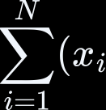



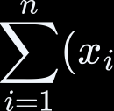

4.1 Variance & Standard Deviation
Population Variance
Sample Variance (Bessel's Correction)
Why
variance.
? Sample mean is estimated from data, using
gives an unbiased estimator of population
[Sampling choice]
Marks: [70, 72, 74, 76, 78]
Mean = 74
Population Variance = 8
Interpretation: The marks vary only slightly around the average, indicating low variability.

Slide 32
4.1.1 Why Divide by (n-1) for Sample Variance?
This is called Bessel's Correction. When we calculate the sample mean from the data itself, we use up one 'degree of freedom.' Dividing by (n-1) instead of n gives an unbiased estimator of the population variance.
Intuitive Explanation
Imagine you have only ONE data point: x = 10 Sample mean = 10
Deviation = (10 - 10) = 0 Variance = 0 / (1-1) = undefined
This makes sense: with only one point, you have NO idea about spread. You need at least 2 points to estimate spread.
When to Use Population vs Sample Variance
Scenario | Use
You have data on ALL members of a group | Population variance (divide by N)
You have a SAMPLE and want to estimate the population | Sample variance (divide by n-1)

Slide 33



Coefficient of Variation (CV)
Business Use: Compare volatility across different scales (e.g., stock A vs stock B).
Example: Comparing Two Investments
Investment | Mean Return | Standard Deviation | CV
A | 10% | 2% | 20%
B | 10% | 5% | 50%
Interpretation:
Investment A (CV = 20%) → More consistent, lower risk. Investment B (CV = 50%) → More variable, higher risk.

Slide 34



4.2 Percentiles & Quartiles
Definitions
Percentile: Value below which
of data falls
Quartiles: (25th), (50th = Median),
Interquartile Range (IQR)
Sort the dataset.
Find Q1 (25th percentile). Find Q3 (75th percentile). Compute:
(75th)

Slide 35








Outlier Detection (Tukey's Fences)
Business Use: Detect fraudulent transactions, anomalous sales.

Slide 36
The interquartile range (IQR)
It is the difference between the third quartile (Q3) and the first quartile (Q1) Measuring how spread out the middle 50% of a dataset is.
It captures variability while minimizing the influence of outliers, making it a robust measure of statistical dispersion.
What the IQR Measures
Middle 50% spread: IQR focuses on the central portion of the data, ignoring the lowest 25% and highest 25%. Robust dispersion: Because extreme values are excluded, IQR provides a stable measure of variability even in skewed distributions.
Outlier detection: Values below Q1 − 1.5×IQR or above Q3 + 1.5×IQR are often flagged as outliers (Tukey’s rule).
Visualization: The IQR corresponds to the box portion of a box plot, showing the central data spread.

Slide 37
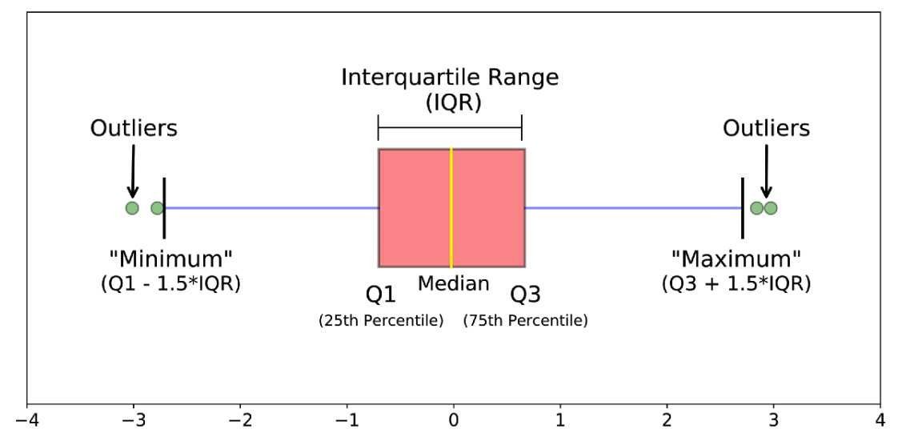
How to interpret box plots

Slide 38
Understanding Quartiles
Dataset sorted: [10, 20, 30, 40, 50, 60, 70, 80]
; N=8
 | 25% |  |  | 25% |  | 25% |  | 25%
 | | v |  |  | | v |  | | v |  | | v
[10, | 20, | 30, | 40 | | | 50, | 60, | 70, | 80]
<--Q1--> | <--Q3-->
| | |
Q1 = 25 | Q3 = 65
(median of | (median of
lower half) | upper half)
The first quartile Q1 is the median of the lower half. (20) and (30)
IQR = Q3 - Q1 = 65 - 25 = 40
The middle 50% of data spans 40 units.
Why IQR is Robust
IQR uses only the middle 50% of data, completely ignoring the bottom 25% and top 25%. This makes it resistant to outliers.

Slide 39

Method 1: The standard textbook method (Tukey)
Finding the Quartile:
[10, 20, 30, 40 | 50, 60, 70, 80]
This method splits the 8 numbers into a lower half and an upper half: Lower half (lowest 50%):
The median of these 4 numbers is the exact middle.
The middle falls between (20) and (30), which gives (25). This leaves exactly two numbers ((10) and (20)) below it.

Slide 40



Method 2: The exact position formula (Mendenhall)
[10, 20, 30, 40 | 50, 60, 70, 80]
Many statistics courses use the formula
to find
A position of (2.25) means you start at the 2nd value ((20)) and go a quarter of the way toward the 3rd value
.
Final Answer
Under neither standard statistical method is equal to the first two values.
It is always a single calculated boundary value (either (25) or (22.5)) that ensures the first two values ((10) and (20)) sit safely below it.

Slide 41

Example: Exam Scores
Sorted Scores: [ 40, 50, 60, 70, 80, 90, 100, 110 ]
Quartile | Value | Meaning
Q1 (25%) | 55 | 25% of students scored 55 or below
Q2 (50%) | 75 | Median; 50% scored 75 or below
Q3 (75%) | 95 | 75% scored 95 or below
First Quartile (Q₁): The th value Second Quartile (Q₂) / Median: The Third Quartile (Q₃): The th value
th value

Slide 42
4.3 Practical: Dispersion in Python
import numpy as np import pandas as pd
# Dataset: Daily website visits
visits = [1200, 1350, 1100, 1450, 1300, 5000, 1250, 1400, 1150, 1380]
# Range
range_visits = np.max(visits) - np.min(visits)
# Variance & Standard Deviation variance = np.var(visits, ddof=1) std_dev = np.std(visits, ddof=1)
# Sample variance [ddof-> Delta Degrees of Freedom.] # Sample std dev
# IQR & Outlier Detection
Q1, Q3 = np.percentile(visits, [25, 75]) iqr = Q3 - Q1
lower_fence = Q1 - 1.5 * iqr
upper_fence = Q3 + 1.5 * iqr
outliers = [v for v in visits if v < lower_fence or v > upper_fence] print(f"Outliers detected: {outliers}") # [5000]

Slide 43


Delta Degrees of Freedom:
In NumPy's numpy.var function, it controls the divisor used in the variance calculation:
N - ddof (where N is the number of data points).
Population Variance (ddof=0): The divisor is N. This is used when your data represents the entire population you are studying.
Sample Variance (ddof=1): The divisor is N - 1 (Bessel's correction). This is used when visits is just a sample of a larger group, giving an unbiased estimate of the true population variance.
Population Standard Deviation (ddof=0): This is the NumPy default.
Sample Standard Deviation (ddof=1):
This applies Bessel's correction.

Slide 44
4.4 Box Plot Visualization
import matplotlib.pyplot as plt
plt.figure(figsize=(8, 5))
plt.boxplot(visits, vert=False, patch_artist=True, boxprops=dict(facecolor='lightblue'))
plt.title('Box Plot: Daily Website Visits') plt.xlabel('Number of Visits')
plt.annotate('Outlier: 5000', xy=(5000, 1), xytext=(4500, 1.2), arrowprops=dict(arrowstyle='->', color='red'))
plt.show()
Interpretation: Box shows IQR, whiskers show 1.5×IQR range, dots = outliers.

Slide 45
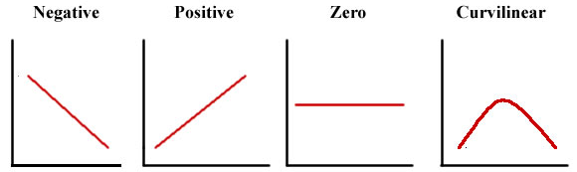
5. Correlation Analysis
Definition
Correlation measures the strength and direction of the relationship between two variables.
Properties
: Perfect positive linear relationship
: Perfect negative linear relationship
: No linear relationship

Slide 46
5.1 Interpreting Correlation
Correlation (r) | Meaning | Real-World Example
+1.0 | Perfect Positive Correlation | Hours studied and exam marks (more study → higher marks)
+0.8 | Strong Positive Correlation | Advertising expenditure and sales revenue
+0.5 | Moderate Positive Correlation | Employee experience and salary
0 | No Correlation | Shoe size and IQ score
−0.5 | Moderate Negative Correlation | Product price and demand
−0.9 | Strong Negative Correlation | Speed of downloading and remaining download time
−1.0 | Perfect Negative Correlation | Distance travelled and distance remaining in a fixed journey

Slide 47


5.1 Interpreting Correlation contd...
|r| Value | Strength | Business Example
0.00 - 0.19 | Very weak | Ad spend vs. shoe sales
0.20 - 0.39 | Weak | Temperature vs. ice cream sales
0.40 - 0.59 | Moderate | Income vs. credit score
0.60 - 0.79 | Strong | Experience vs. salary
0.80 - 1.00 | Very strong | Study hours vs. exam scores
Caution: Correlation Causation!
Correlation means two variables move together, while Causation means one event causes the other.

Slide 48
Important Caveat
Correlation does NOT imply Causation!
Example: Ice cream sales correlate with drowning incidents. Does ice cream CAUSE drowning? NO!
Both are caused by a third variable: HOT WEATHER.
More people buy ice cream AND more people swim when it's hot.
Causation is the process or relationship where one event (the cause) directly produces or leads to another event (the effect)
Correlation means two variables move together, while Causation means one event causes the other.

Slide 49











Pearson Correlation Coefficient
Definition
The Pearson correlation coefficient (denoted as (r)) measures the strength and direction of the linear relationship between two variables. It ranges from (-1) to (1).
The standard algebraic formula is:
Where:
: Number of data points or pairs
: Sum of the individual values of variables (x) and (y).
: Sum of the products of each pair of (x) and (y) values
: Sum of the squared individual values

Slide 50






Pearson Correlation Coefficient
Alternative Formula (Using Means) The coefficient can also be calculated by dividing the covariance of the two variables by the product of their standard deviations:

Slide 51
We saw two methods to calculate the Pearson Correlation Coefficient:
Direct (Raw Score) Method – Uses ΣX, ΣY, ΣXY, ΣX², ΣY².
Mean (Deviation) Method – Uses deviations from the mean (x = X − X̄, y = Y − Ȳ).
The answer is always the same.
The only difference is the calculation approach.
Both methods always produce the same Pearson correlation coefficient.
They differ only in the intermediate calculations.

Slide 52
Example: Study Hours vs Marks
Student | X (Hours) | Y (Marks) | XY | X² | Y²
A | 1 | 50 | 50 | 1 | 2500
B | 2 | 60 | 120 | 4 | 3600
C | 3 | 65 | 195 | 9 | 4225
D | 4 | 80 | 320 | 16 | 6400
E | 5 | 90 | 450 | 25 | 8100
Total | 15 | 345 | 1135 | 55 | 24825
Formula
Where:
X = Independent variable; Y = Dependent variable; n = Number of observations

Slide 53
Student | X (Hours) | Y (Marks) | XY | X² | Y²
A | 1 | 50 | 50 | 1 | 2500
B | 2 | 60 | 120 | 4 | 3600
C | 3 | 65 | 195 | 9 | 4225
D | 4 | 80 | 320 | 16 | 6400
E | 5 | 90 | 450 | 25 | 8100
Total | 15 | 345 | 1135 | 55 | 24825
Here,
n = 5; ΣX = 15; ΣY = 345
ΣXY = 1135; ΣX² = 55; ΣY² = 24825
Step 1: Calculate the Numerator n∑XY−∑X∑Y
=(5×1135)−(15×345)
=5675−5175=500
Step 2: Calculate the Denominator
First part: n∑X²−(∑X)²
=(5×55)−15²=275−225=50
Second part:
n∑Y²−(∑Y)²
=(5×24825)−345² =124125−119025=5100

Slide 54


Second part:
n∑Y²−(∑Y)²
=(5×24825)−345² =124125−119025=5100
Therefore,
= ≈504.98
Step 3: Calculate Pearson Correlation r= 500/504.98
r≈0.99 Interpretation
r = +0.99
This indicates a very strong positive correlation. As study hours increase, marks also increase.

Slide 55
Difference Between the Two Methods
Direct (Raw Score) Method | Mean (Deviation) Method
Uses X and Y directly | Uses deviations from the mean
Uses ΣX, ΣY, ΣXY, ΣX², ΣY² | Uses Σxy, Σx², Σy²
Formula is longer | Formula is shorter
Convenient for calculators/computers | Convenient for manual calculations and exams
No need to calculate mean first | Mean must be calculated first
Final answer is the same | Final answer is the same
Exam Tip
If the question already provides X̄ (mean) or asks you to prepare a deviation table, use the Mean Method.
If the question only gives X and Y values, the Direct Method is often faster because it avoids creating deviation columns.

Slide 56
5.2 Spearman's Rank Correlation
Spearman's Rank Correlation measures the strength and direction of the relationship between two ranked variables.
When to Use
Data is in the form of ranks (1st, 2nd, 3rd, ...). Data is ordinal
Relationship is monotonic but not linear (The relationship may not be perfectly linear.) Outliers are present

Slide 57
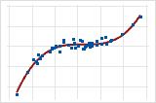
Monotonic vs Linear relationship
In a monotonic relationship, the variables tend to move in the same relative direction, but not necessarily at a constant rate.
In a linear relationship, the variables move in the same direction at a constant rate.
source: https://support.minitab.com/en-us/minitab/help-and-how-to/statistics/basic-statistics/supporting-topics/basics/linear-nonlinear-and-monotonic-relationships/

Slide 58





5.2 Spearman's Rank Correlation [formula]
where
= Spearman's Rank Correlation Coefficient d = Difference between the two ranks
d² = Square of the rank difference n = Number of observations

Slide 59
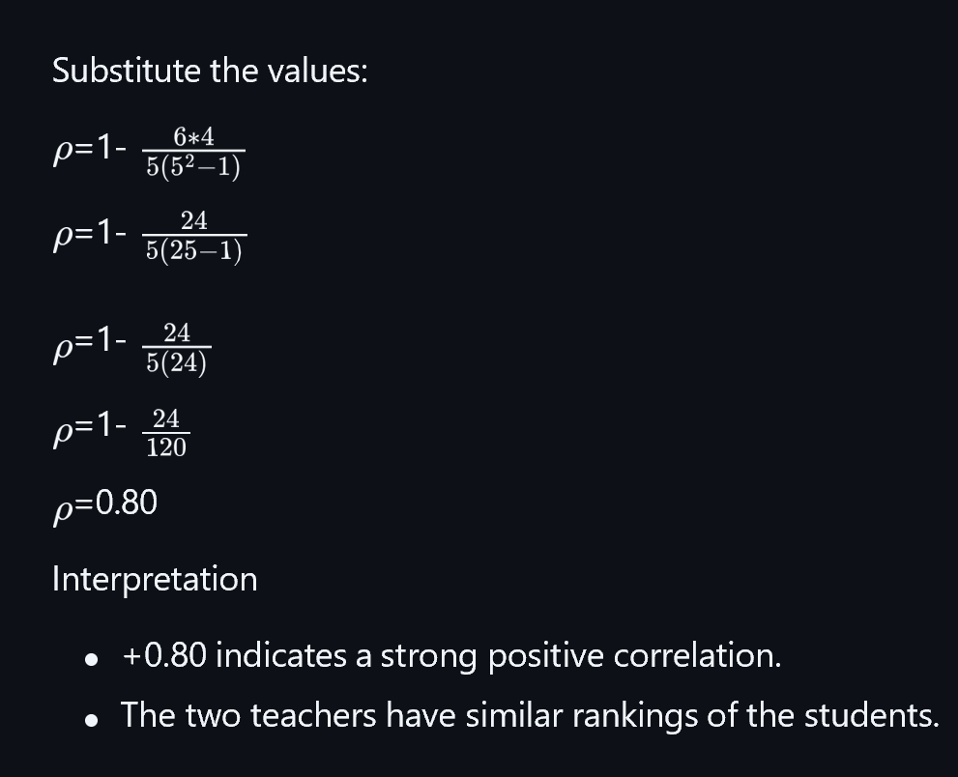

Example: Suppose two teachers rank five students.
Student | Rank by Teacher A (X) | Rank by Teacher B (Y) | d = X − Y | d²
A | 1 | 2 | -1 | 1
B | 2 | 1 | 1 | 1
C | 3 | 3 | 0 | 0
D | 4 | 5 | -1 | 1
E | 5 | 4 | 1 | 1
Total |  |  |  | 4
Here,
n = 5 ; Σd² = 4

Slide 60



Substitute the values:
=1-
=1-
=1-
=1-
=0.80
Interpretation
+0.80 indicates a strong positive correlation.
The two teachers have similar rankings of the students.

Slide 61
5.3 Practical: Correlation in Python
import pandas as pd import numpy as np
import matplotlib.pyplot as plt
import seaborn as sns
# Business dataset df = pd.DataFrame({
'Ad_Spend': [10, 15, 20, 25, 30, 35, 40, 45, 50, 55],
'Sales': [120, 180, 220, 280, 310, 350, 400, 450, 490, 530],
'Customer_Satisfaction': [3.5, 3.8, 4.0, 4.2, 4.1, 4.3, 4.5, 4.6, 4.7, 4.8]
})
# Pearson Correlation Matrix corr_matrix = df.corr(method='pearson') print(corr_matrix)
# Visualization plt.figure(figsize=(8, 6))
sns.heatmap(corr_matrix, annot=True, cmap='coolwarm', center=0,
square=True, linewidths=0.5) plt.title('Correlation Heatmap: Business Metrics') plt.show()

Slide 62
5.4 Scatter Plot with Regression Line
import seaborn as sns
plt.figure(figsize=(8, 6)) sns.regplot(x='Ad_Spend', y='Sales', data=df,
scatter_kws={'s': 100, 'color': 'blue'},
line_kws={'color': 'red'})
plt.title(f'Ad Spend vs Sales (r = {df["Ad_Spend"].corr(df["Sales"]):.3f})') plt.xlabel('Advertising Spend ($1000s)')
plt.ylabel('Sales ($1000s)')
plt.grid(True, alpha=0.3) plt.show()

Slide 63
6. Summary & Key Takeaways
Concept | Key Formula / Point
Mean
Median | Middle value of sorted data
Mode | Most frequent value
Variance
Std. Dev
IQR
Pearson

Slide 64
Decision making flow tree: Which Measure?
Data Type?
├── Categorical → Mode
└── Numerical
├── Symmetric? → Mean + SD
└── Skewed? → Median + IQR

Slide 65
Exercises
Compute mean, median, mode for: [23, 29, 20, 32, 23, 21, 33, 25]
Find variance and standard deviation for the above data
Detect outliers using IQR method for: [12, 15, 14, 18, 20, 22, 100, 16]
Calculate Pearson correlation between study hours and exam scores (assume date of 5 students)
Interpret a correlation of between marketing spend and revenue

Slide 66
References
Prasad, R.N. & Acharya, S. — Fundamentals of Business Analytics (Wiley)
Maheshwari, A. — Data Analytics (McGraw Hill)
Albright, S.C. & Winston, W.L. — Business Analytics: Data Analysis & Decision Making (Cengage)

Slide 67
End of Unit I
Descriptive Statistics & Data Understanding
Next: Unit II — Inferential Statistics & Hypothesis Testing

